Slide 1
Attendance System
By Robert Kiliszewski | Adrian Sypos | Adrian Golias

Slide 2
Objectives
Remove pen and paper approach
Stop students from signing in their colleagues
Store data in a remote database
Use an API to communicate with the database between apps

Slide 3
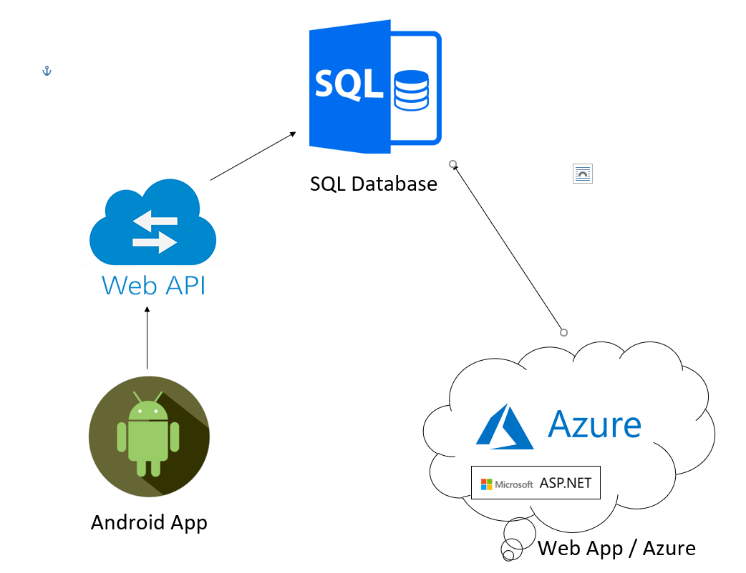
Architecture

Slide 4
Conclusion
Challenging to learn new technologies
Teamwork didn’t always go as planned
Time pressure
Great overall learning experience

Slide 5
Thank you for listening
We will be happy to answer any Questions

